Slide 1
God
Why would we want to change?
The purpose of sanctification…
Church
Christ
Peoples

Slide 2
God
Genesis 1
God created man and woman in his image, to be like him.
God created them in his image so they could rule for him.
Two Goals:
Reflect God’s character
Represent God on Earth
Family
Man
Creation

Slide 3
God
Genesis 12
God chose to equip Israel so they could reflect his character.
God equipped them so they could represent him to the other nations.
Two Goals:
Reflect God’s character
Represent God on Earth
Israel
King
Nations

Slide 4
God
1 Peter 2.9-10
God created the church
so we could reflect his character.
God commands us to represent
him to the other peoples.
Two Goals:
Reflect God’s character
Represent God on Earth
Church
Christ
Peoples

Slide 5
God
God
God
Israel
Family
King
Man
Church
Christ
Creation
Nations
Peoples

Slide 6
God
Romans 8.29
God predestined you to become conformed to the image of Christ.
Thus you become what you were created to be, the image of God.
Two Goals:
Reflect God’s character
Represent God on Earth
Church
Christ
Peoples

Slide 7
God
Ephesians 2.10 [NET]
“For we are his workmanship,
having been created in Christ Jesus
for good works that God prepared beforehand so we may do them.”
Church
Christ
Peoples

Slide 8
God
Titus 2.11-14 [NET]
“For the grace of God … trains us to reject godless ways and worldly desires and to live self-controlled, upright, and godly lives in the present age…
[Christ] gave himself for us to set us free from every kind of lawlessness and to purify for himself a people who are truly his, who are eager to do good.”
Church
Christ
Peoples

Slide 9
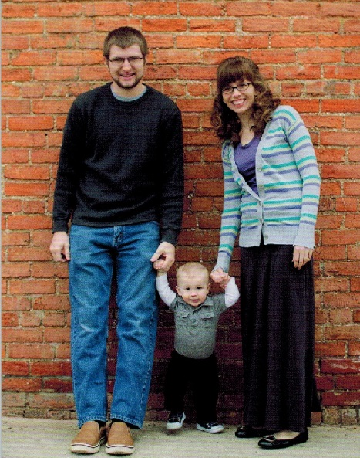
God
Matthew Willett, age one year
Church
Christ
Peoples

Slide 10
Hebrews 10.10 [NET]: “By his [God’s] will we have been made holy through the offering of the body of Jesus Christ once for all.”

Slide 11
Hebrews 10.10 [NET]: “By his [God’s] will we have been made holy through the offering of the body of Jesus Christ once for all.”
Romans 3.23-24 [NASB]: “for all have sinned and fall short of the glory of God, being justified as a gift by His grace through the redemption which is in Christ Jesus…”

Slide 12
Hebrews 10.10 [NET]: “By his [God’s] will we have been made holy through the offering of the body of Jesus Christ once for all.”
Romans 3.23-24 [NASB]: “for all have sinned and fall short of the glory of God, being justified as a gift by His grace through the redemption which is in Christ Jesus…”
Romans 6.22 [NASB]: “But now having been freed from sin and enslaved to God, you derive your benefit, resulting in sanctification, and the outcome, eternal life.”

Slide 13
1 Corinthians 6.11 [NET]: “Some of you once lived this [evil] way. But you were washed, you were sanctified, you were justified in the name of the Lord Jesus Christ and by the Spirit of our God.”

Slide 14
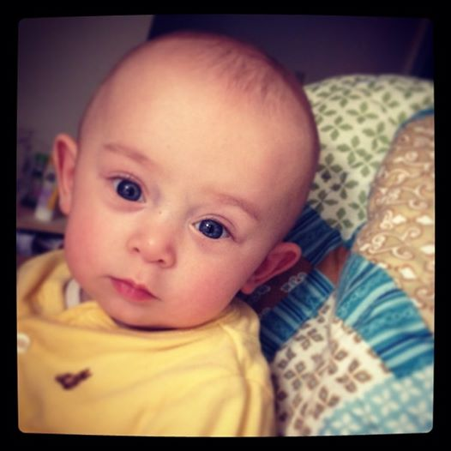
1 Corinthians 6.11 [NET]: “Some of you once lived this [evil] way. But you were washed, you were sanctified, you were justified in the name of the Lord Jesus Christ and by the Spirit of our God.”
William Baillie, age five months

Slide 15
1 Corinthians 6.11 [NET]: “Some of you once lived this [evil] way. But you were washed, you were sanctified, you were justified in the name of the Lord Jesus Christ and by the Spirit of our God.”
Titus 3.5-6 [NET]: “He saved us not by works of righteousness that we have done but on the basis of his mercy, through the washing of the new birth and the renewing of the Holy Spirit, whom he poured out on us in full measure through Jesus Christ our Savior.”

Slide 16
Ephesians 2.1-5 [NET]: “And although you were dead in your transgressions and sins, in which you formerly lived according to this world's present path, according to the ruler of the kingdom of the air, the ruler of the spirit that is now energizing the sons of disobedience, among whom all of us also formerly lived out our lives in the cravings of our flesh, indulging the desires of the flesh and the mind, and were by nature children of wrath even as the rest…
But God, being rich in mercy, because of his great love with which he loved us, even though we were dead in transgressions, made us alive together with Christ– by grace you are saved!”

Slide 17
Positional Sanctification:
God transfers your legal status from sinner to saint, separating you out from the world to be a part of his people in the church.
Progressive Sanctification:
God changes you in character and behavior from sinner to saint, so that you experientially become one of his people, reflecting his character and representing him well.
God
Church
Christ
Peoples

Slide 18
1 Thessalonians 5.23 [NET]:
“Now may the God of peace himself make you completely holy
and may your spirit and soul and body be kept entirely blameless at the coming of our Lord Jesus Christ.”
Progressive Sanctification:
God changes you in character and behavior from sinner to saint, so that you experientially become one of his people, reflecting his character and representing him well.
God
Church
Christ
Peoples

Slide 19
Benefits of Progressive Sanctification:
Become the strong, confident, capable person God designed you to be!

Slide 20
Benefits of Progressive Sanctification:
Become the strong, confident, capable person God designed you to be!
Learn to live in a way that blesses you more while blessing others more too!

Slide 21
Benefits of Progressive Sanctification:
Become the strong, confident, capable person God designed you to be!
Learn to live in a way that blesses you more while blessing others more too!
Develop into God’s man or woman, who reflects his character and represents him well!

Slide 22
Benefits of Progressive Sanctification:
1 Corinthians 3.1-3 [NET]:
“So, brothers and sisters, I could not speak to you as spiritual people, but instead as people of the flesh, as infants in Christ. I fed you milk, not solid food, for you were not yet ready. In fact, you are still not ready, for you are still influenced by the flesh. For since there is still jealousy and dissension among you, are you not influenced by the flesh and behaving like unregenerate people?”

Slide 23
Benefits of Progressive Sanctification:
1 Peter 2.2-3 [NIV]:
“Like newborn babies, crave pure spiritual milk, so that by it you may grow up in your salvation, now that you have tasted that the Lord is good.”

Slide 24
Benefits of Progressive Sanctification:
Hebrews 5.11-14 [NIV]:
“We have much to say about this, but it is hard to make it clear to you because you no longer try to understand. In fact, though by this time you ought to be teachers, you need someone to teach you the elementary truths of God's word all over again. You need milk, not solid food! Anyone who lives on milk, being still an infant, is not acquainted with the teaching about righteousness. But solid food is for the mature, who by constant use have trained themselves to distinguish good from evil.”

Slide 25
Benefits of Progressive Sanctification:
Ephesians 4.14 [NET]:
“So we are no longer to be children, tossed back and forth by waves and carried about by every wind of teaching by the trickery of people who craftily carry out their deceitful schemes.”

